Slide 1
Analysis of MRI image data for Alzheimer disease detection using deep learning techniques
Nilanjana Pradhan, Shrdhha Sagar1, Ajay Shankar Singh1 (2023)
21241057 Malika Muradi

Slide 2
Abstract:
leading cause of death worldwide
Alzheimer's Disease: A Global Health Challenge
Early diagnosis is paramount to improving outcomes and patient care.
Utilizing Imaging, EHR, and SNP Datasets

Slide 3
Methodology
Imaging dataset
Importance of Medical Imaging
Preprocessing MRI Scans
Enhancing Image Quality
EHR dataset
Electronic Health Records (EHR)
Beyond Clinical Records
SNP dataset
Single Nucleotide Polymorphisms (SNP)
Genetic Variations
Insights into Disease Connections
CNN
Convolution, Max Pooling, Dropout

Slide 4
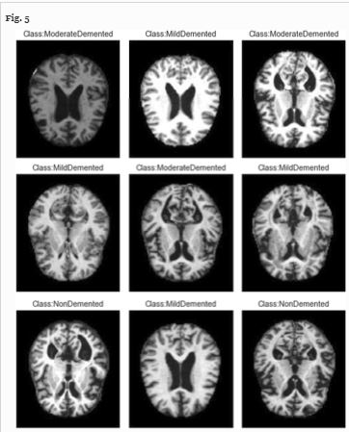
Imaging Dataset:

Slide 5
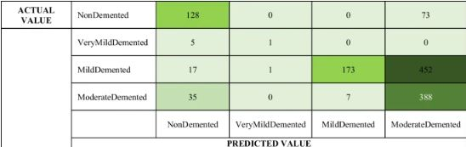
Result:

Slide 6
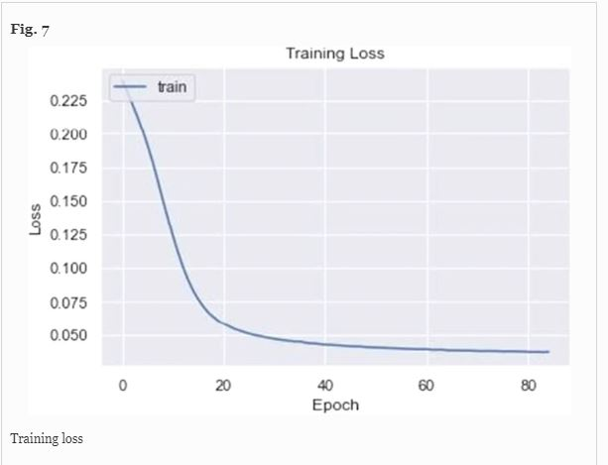
EHR dataset:

Slide 7
Conclusion:
A Step Toward Early Diagnosis
Enhancing Alzheimer's Detection

Slide 8
THANK YOU

